Slide 1

Innov8 Employee Attrition Report

Slide 2
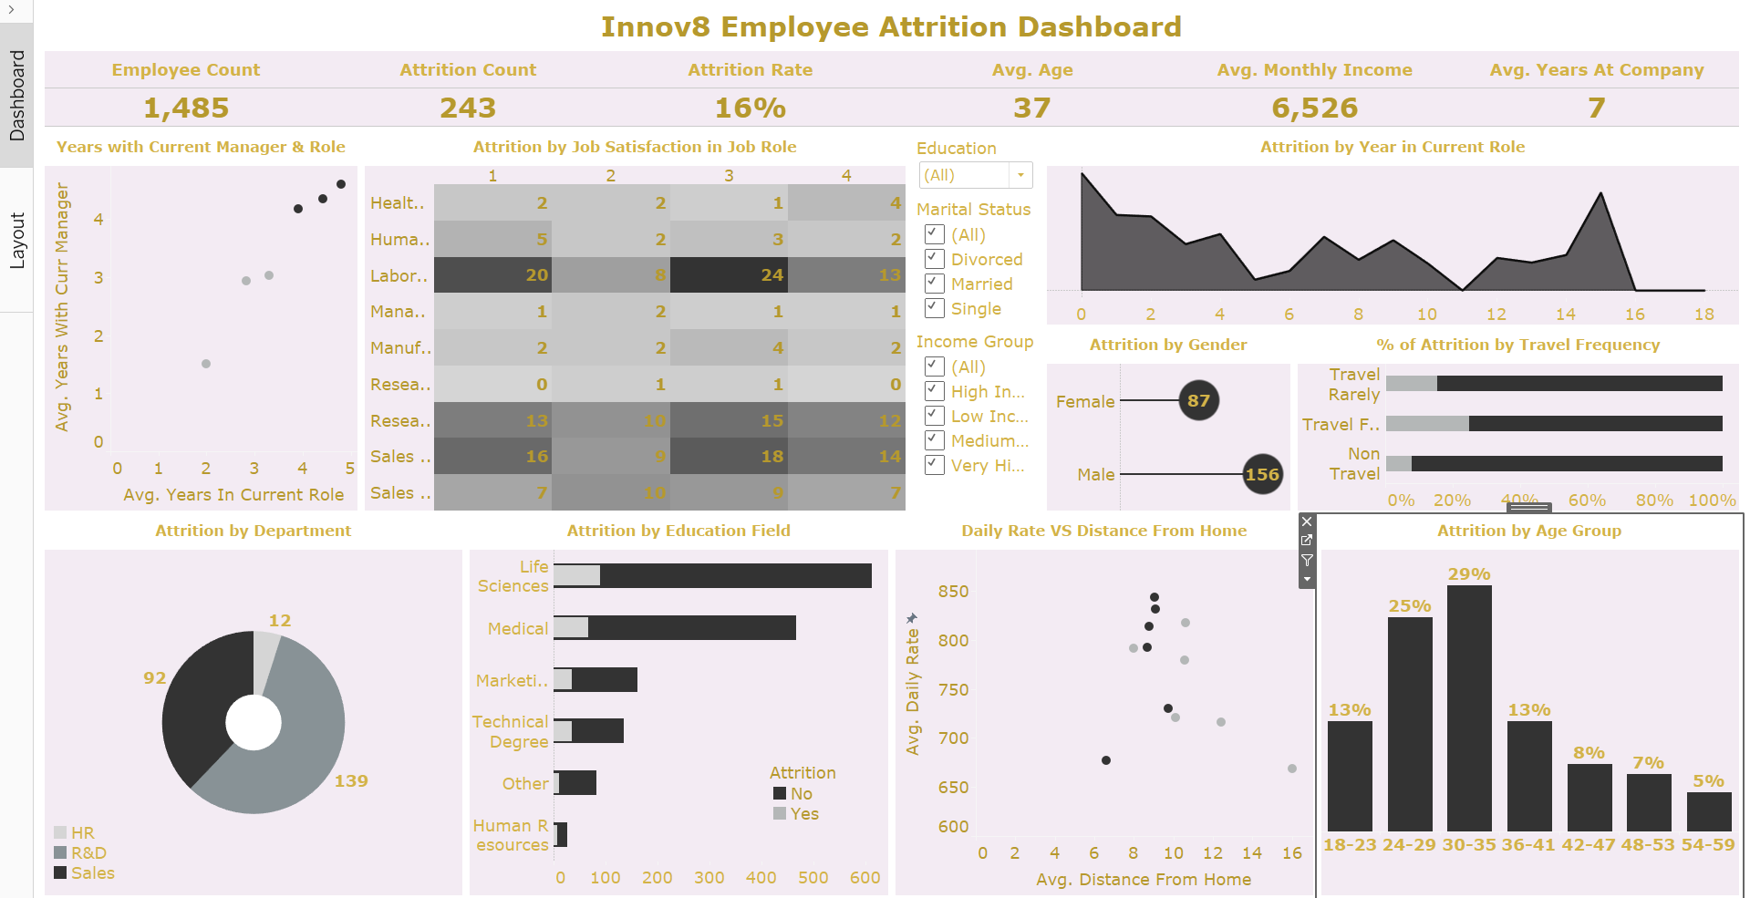

Slide 3

Insights Generated
Innov8 is a company with close to 1500 employees. However, it is faced with an attrition rate of 16% where 243 of its staff have resigned;
156 of the staff who resigned are male while 87 are female;
Employees within the age group 30-35 have the highest attrition rate followed by employees within the age group 24-29;
The attrition rate begins to decline in employees between the ages of 36 to 60;
The department with the highest attrition count is the Research and Development department while the least is the Human Resources department;

Slide 4

More Insights Generated
Employees in the Laboratory Technician role have the highest attrition count followed by employees in the Sales Executive role;
Employees who travel frequently have the highest attrition rate;
The attrition count increases for employees whose education level is between 1 and 3. However, it starts to reduce for employees with higher education levels;
Single employees have the highest attrition count followed by married employees;
Employees in the Low and Middle Income Group have the highest attrition count;

Slide 5

Recommendations
To reduce the attrition rate in the company, the management can incentivize employees between the ages of 24 to 35 by increasing their salaries after conducting a salary review session or by promoting them to make them feel appreciated;
There should be a yearly employee review and regular promotion opportunities for the employees to look forward to. This can take place once in three years;
The management should create an opportunity for a good work-life balance for employees who travel frequently. The number of times they travel should be reduced if possible. If not, the management can make their trips more comfortable by lodging them in good hotels and making them fly or travel more comfortably. The employees can also be given a couple of days to rest after their trips to make them more relaxed and ready for work;
The management can also conduct or sponsor workshops or trainings for employees with lower education levels to increase their knowledge and confidence at work.

